Slide 1
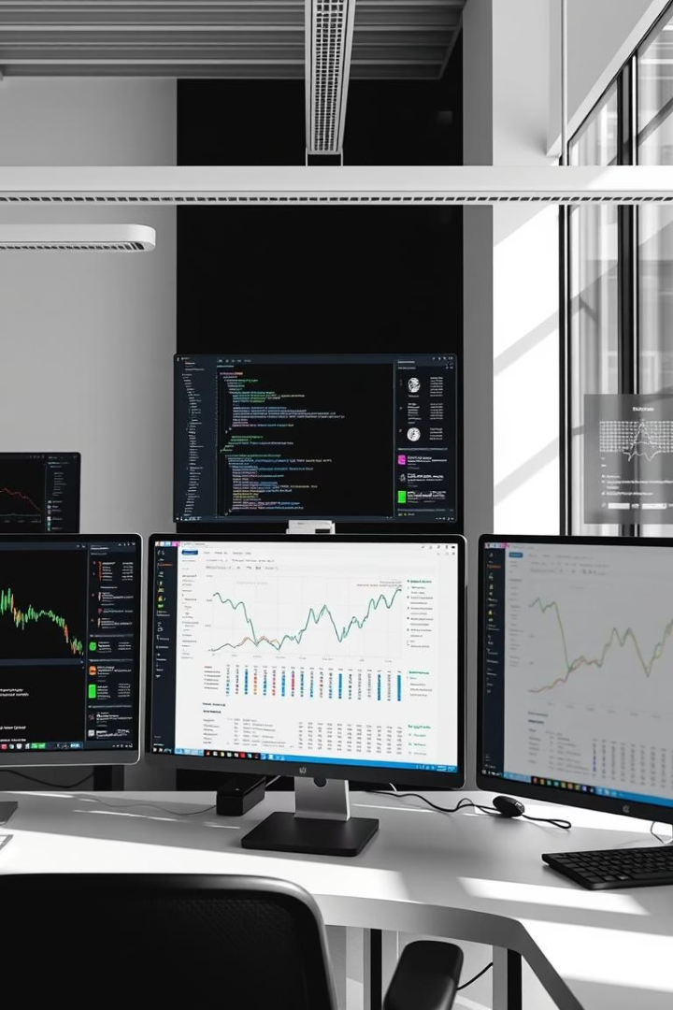
Pandas & Matplotlib Overview
Today’s Agenda
Introduction to Pandas (Series & DataFrames)
Filtering and Data Analysis
Plotting & Visualizing with Matplotlib
Reading and Processing CSV Files
Hands-On Practice
Kahoot(Quiz)

Slide 2
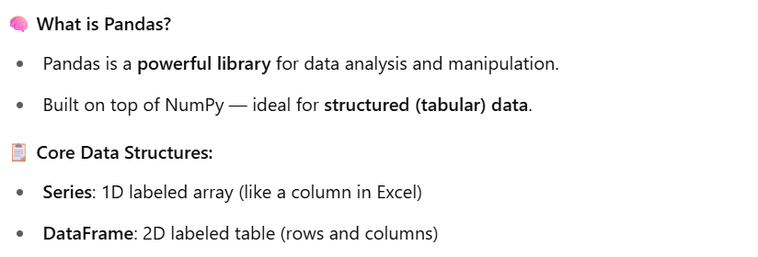
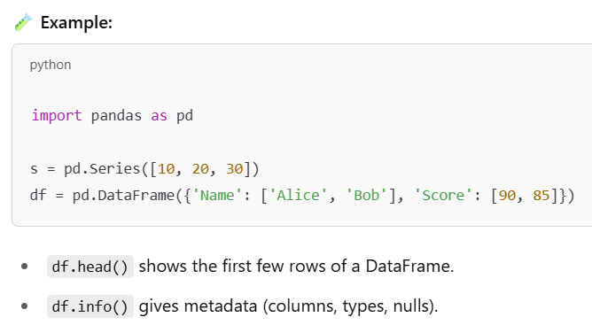
Pandas – Series & Data Frames

Slide 3
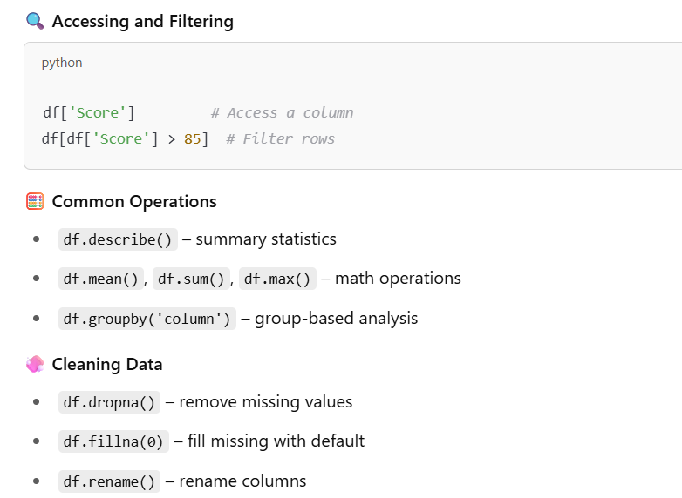
Filtering and Data Analysis

Slide 4
Short break

Slide 5
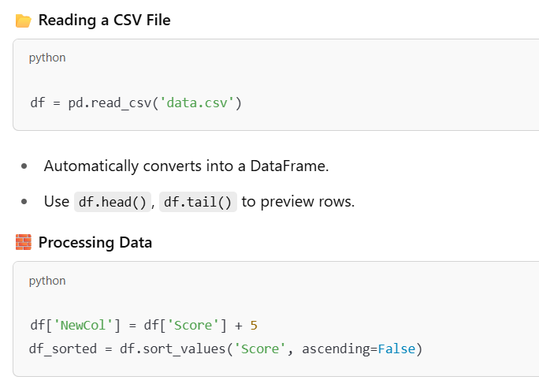
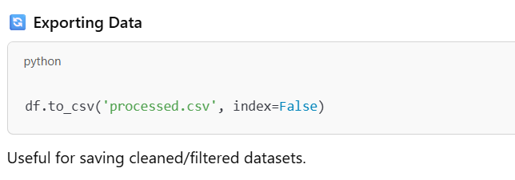
Reading CSV & Processing Data

Slide 6
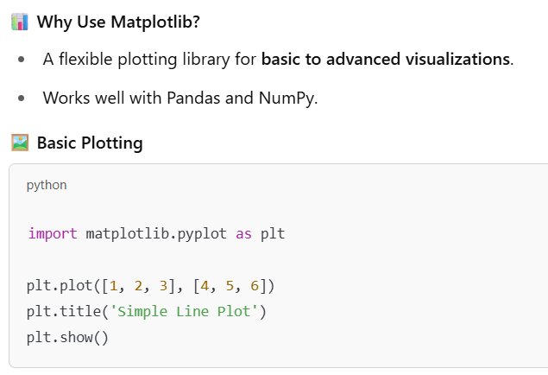
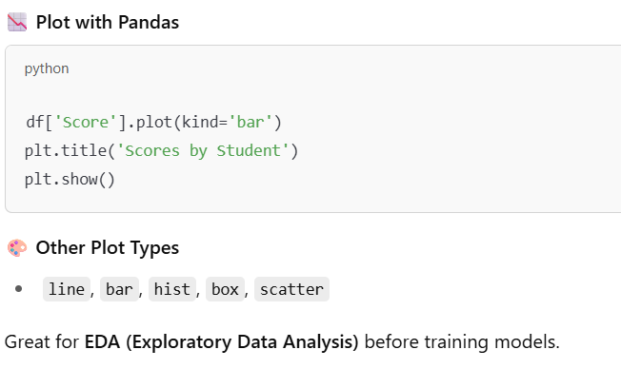
Data Visualization with Matplotlib

Slide 7
Main Break

